Slide 1

Business Growth Strategy for Hosts on Airbnb Platform

Slide 2




Meet the Team
Priyam Sarkar
Samridhi Vats
Priyanka Shinde
Nagraj Deshmukh

Slide 3
Executive Summary of Findings
Airbnb's business model embodies a quintessential platform-based structure, capitalizing on the network effect where the value of its service increases with each additional user, aligning with Metcalfe's Law. Our comprehensive analysis bolstered by predictive and prescriptive modelling provided strategic insights leading to value extraction for hosts of Airbnb platform. We undertook an exhaustive study of the potential new entrants and existing hosts to understand the competitive landscape better.
Superhost Program & Revenue Impact: Data from the Superhost Certification Program highlighted a stark contrast in earnings, with Superhosts significantly outperforming regular hosts. The rigorous statistical tests underscore the program's influence on revenue, customer satisfaction, and repeat bookings.
City Selection & Market Entry: Focused analysis on city and tract selection criteria revealed key indicators that guide potential new entrants in identifying lucrative city and tracts for market entry. The study demonstrated that certain tracts within chosen cities present substantial revenue-generating potential.
Market Expansion Strategy: For existing hosts, the model pinpoints factors in hosts’ control that affect revenue on basis of seasonality demand. These controllable factors, along with responsive strategies to seasonality and market demands, are pivotal in driving revenue growth.
Challenges and Future Scope: Our project navigated through data inconsistencies and missing values to ensure robust model performance. The final recommendation underscores the vital role of data-driven strategies in maximizing value extraction for hosts of Airbnb platform to ultimately boost revenue growth. Due to time constraint, we have analyzed value extraction for hosts but for future scope, we can incorporate value creation for guests as well.
By integrating these findings, hosts can leverage key features for differentiation and competitive advantage, ultimately leading to sustained growth and value extraction on Airbnb platform.

Slide 4
Problem Statement
Growth Strategy
New Entrants
Existing Host
Selection of Tract
Property listing
Nightly Rate
Market Responsiveness
Nightly Rate
Market Entry
Market Expansion
City Selection

Slide 5

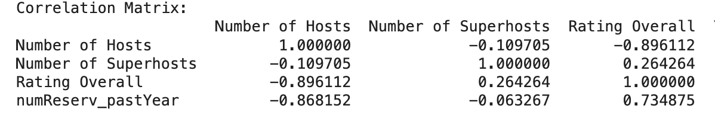
Network Effect of Airbnb
Multi layered competition for Host in Airbnb platform
Host
Customer
Host
Customer
With intense competition, value creation for host is challenging.
However, data driven business recommendation and growth strategy can solve the problem.
Because of the Project Limitation, we will analyze one side of Network effect and we have chosen Host.

Slide 6
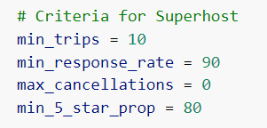
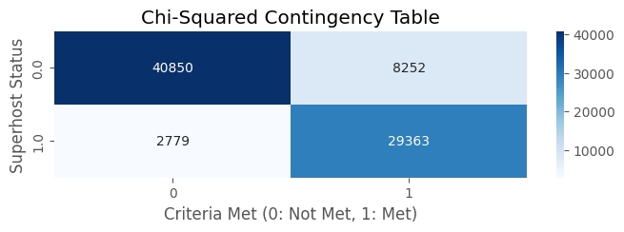
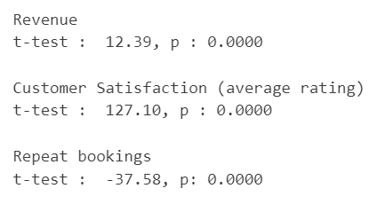
Super Host Certification Program
Superhosts, on average, generate higher revenue than non-Superhosts.
Superhosts have higher customer satisfaction ratings.
Non-Superhosts have a higher number of reservations on average compared to Super hosts.

Slide 7
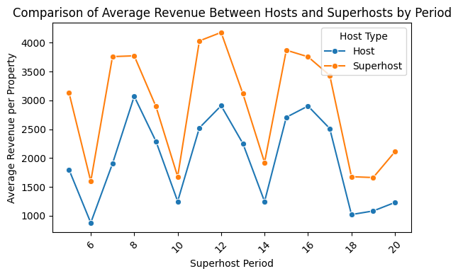
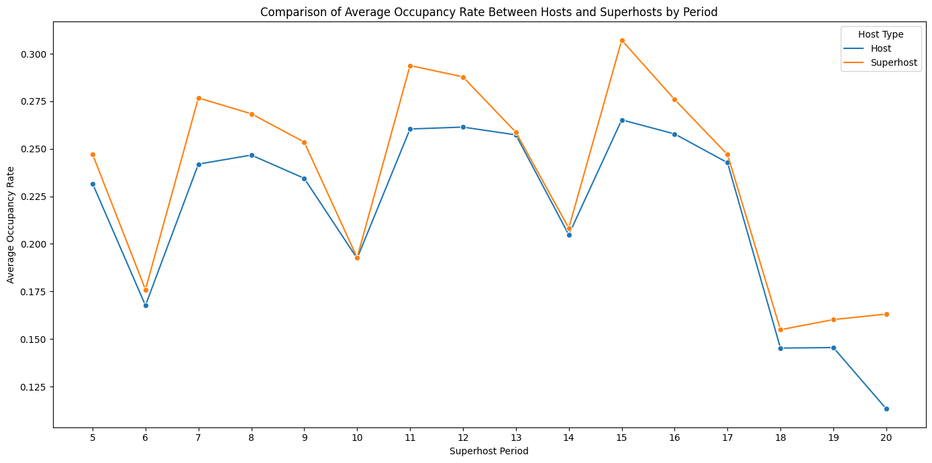
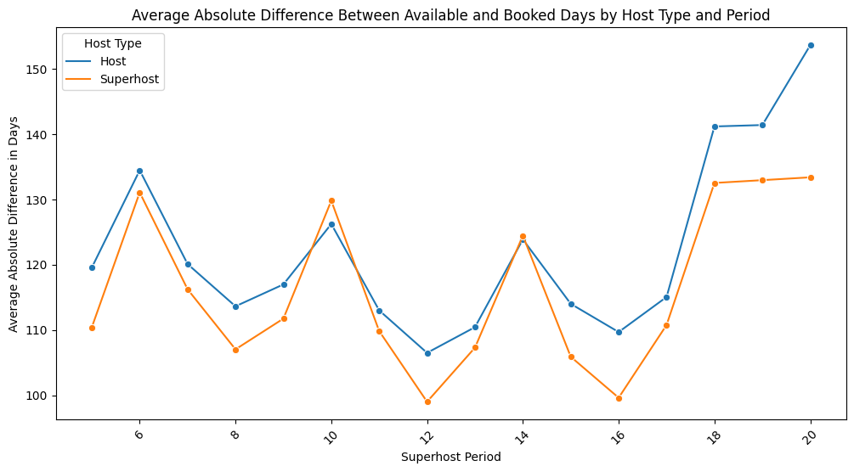
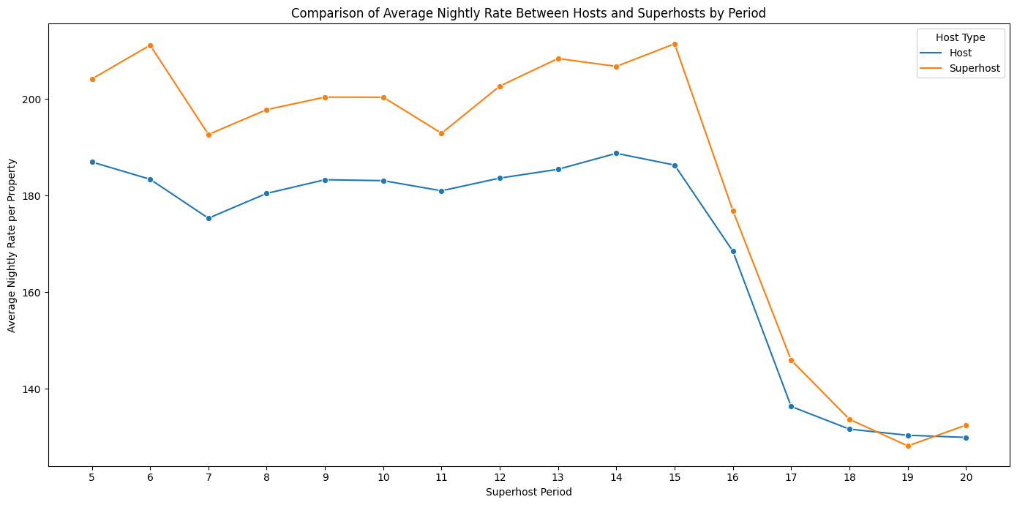
Super Value Creation!

Slide 8
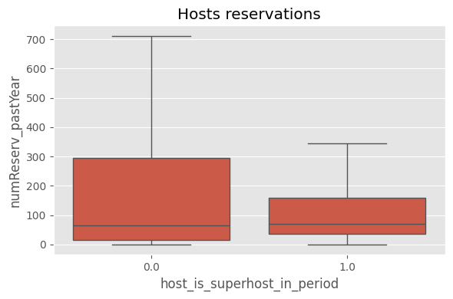
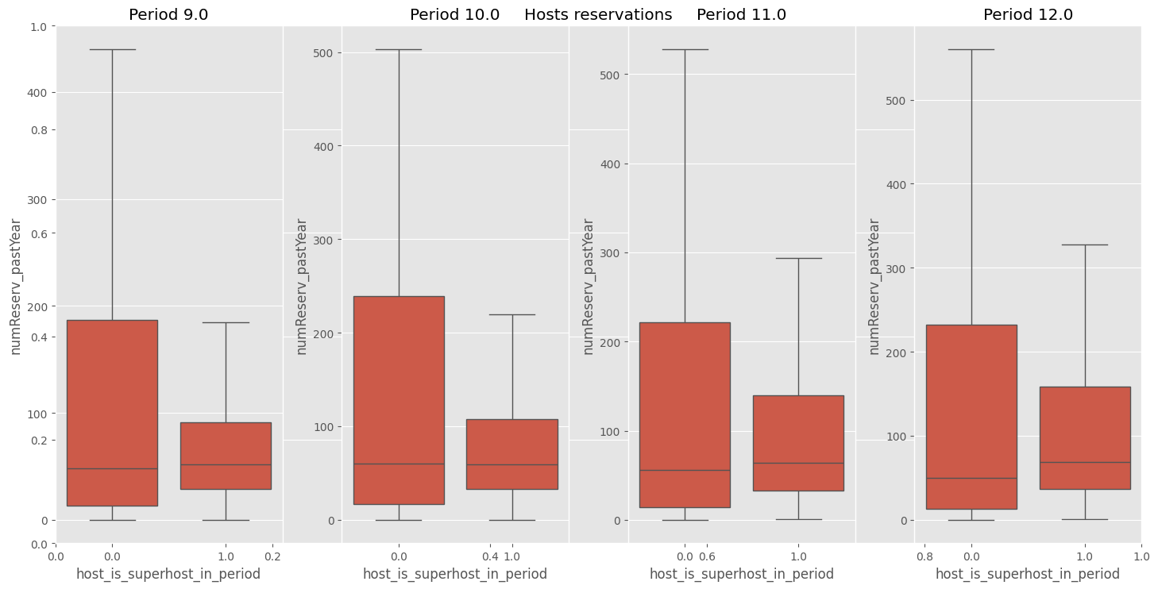
Superhost Status Boosts New Entrants' Business
Avg. consecutive period for which a host retains its superhost status ~ 3
1. Easier for new entrants to achieve superhost status initially.
2. Challenges in retaining superhost status for more than 3 evaluation periods.
Superhost status might provide an initial reservation boost but leads to increased cancellations, potentially resulting in status loss within a few periods.

Slide 9
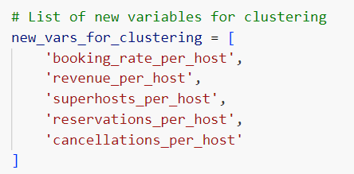
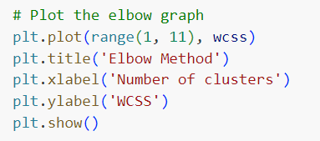
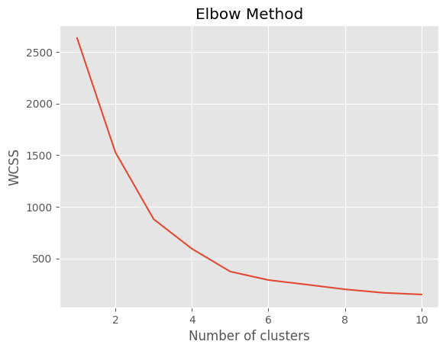
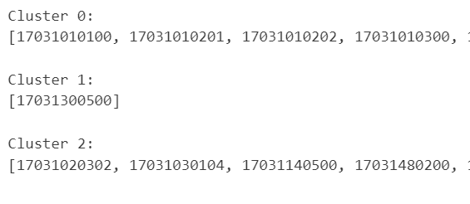
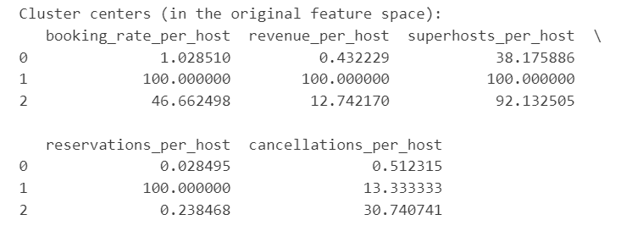
Market Entry Strategy of New host
1
2
For a chosen city, which tract(s) to venture into?
1
Tract Analysis & Feature Selection
3
(Per total hosts)
5
2
Tract Clustering
Selected tract
3
Optimal no. of Cluster Determination
4
4
Competitive Landscape in Clustered Tracts
5
Final Tract Selection

Slide 10
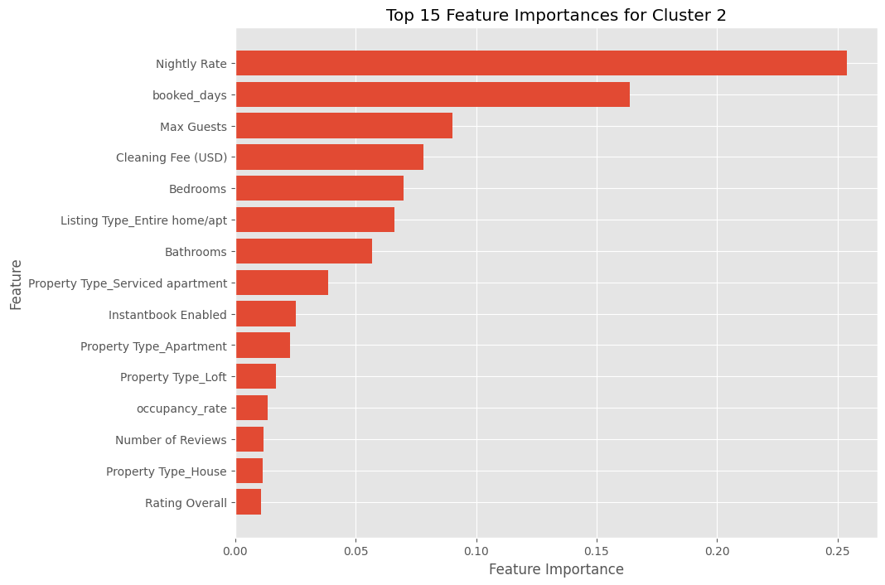
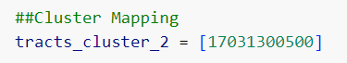
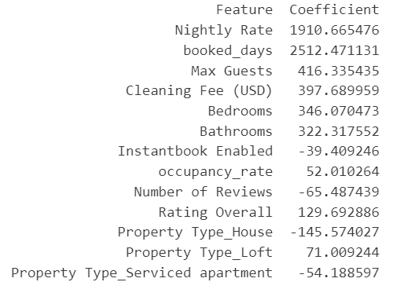
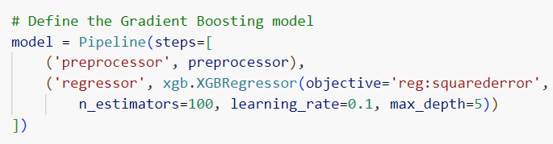
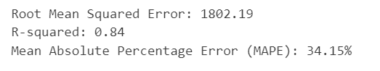
Revenue Drivers in the “Chosen Tract”
Analyzing Competitive environment within High potential Tracts
Important Feature for Tract 2
Finalized Tract in Chicago
XGBoost Model
Predictive analysis to help hosts understand key features for differentiation and competitive positioning

Slide 11
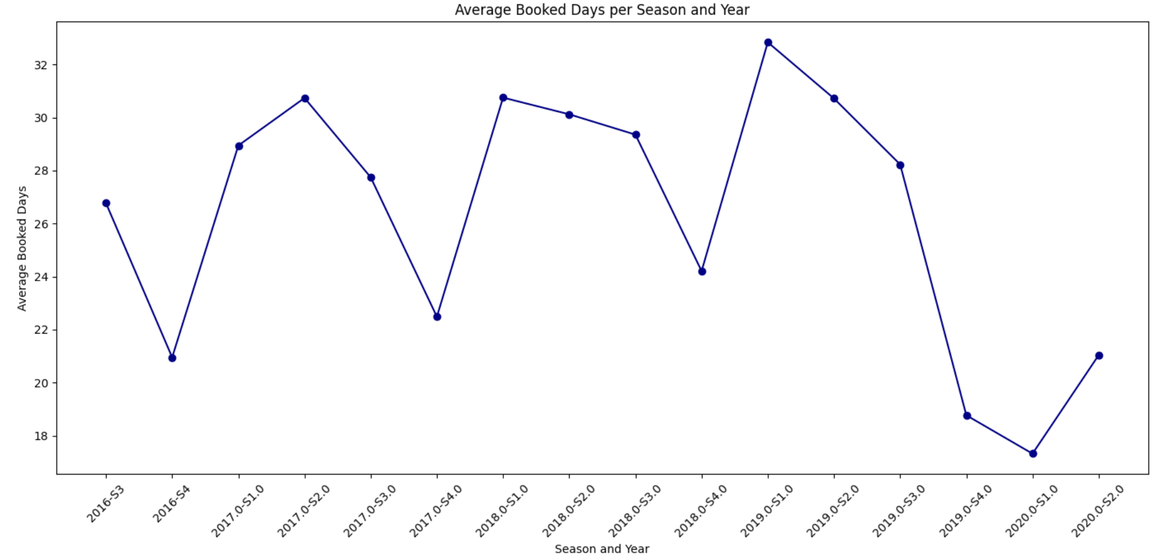
Market Responsiveness
Assessing Demand Seasonality Needs
Demand Seasonality in booking pattern
Market Responsive
Controllable factor
Uncontrollable Factor

Slide 12
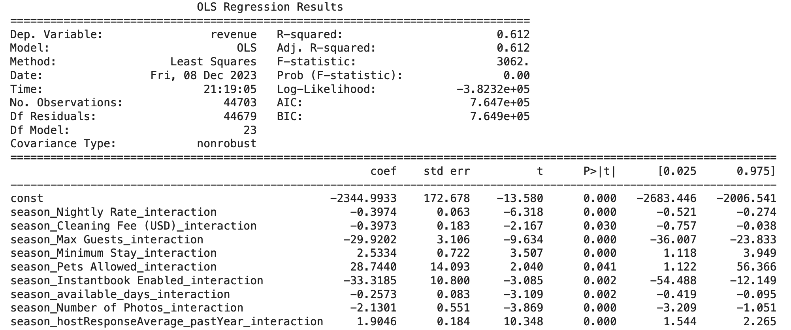
Impact of Controllable Factors and Seasonality on Revenue
Controllable Factors
1. Nightly Rate
2. Cleaning Fee (USD)
3. Maximum Guests
4. Minimum Stay
5. Pets Allowed
6. Instant Book Enabled
7. Available Days
8. Number of Photos
9. Response Time

Slide 13
Nightly Rate Recommendation for Both Existing Host and New Host
Model Selection - XGBoost
Model Training
Feature Selection
Nightly Rate Prediction

Slide 14
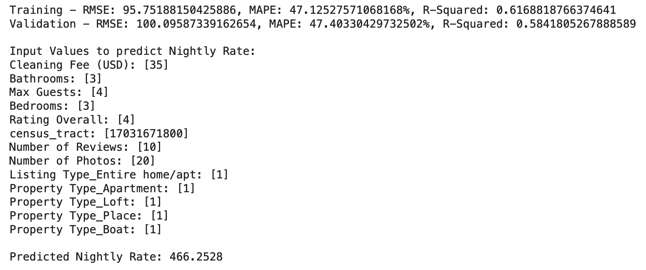
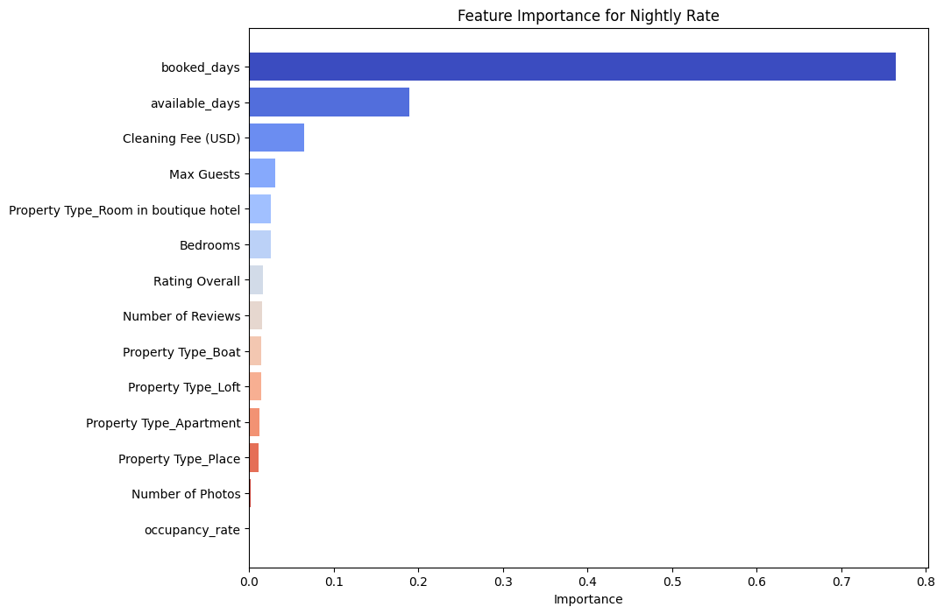
Nightly Rate Recommendation for Both Existing Host and New Host

Slide 15
Conclusion
New Entrants
Existing Hosts
City & Tract Selection
Analyze Demand Seasonality
New Hosts
Property Listing
Market Responsiveness
Earn Revenue
Super Host
Value Extraction
Super Host

Slide 16
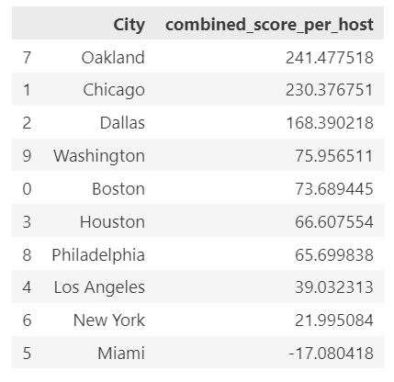
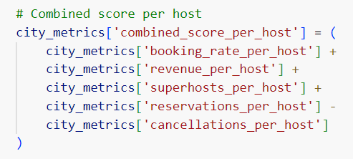
Basis of City Selection and Outcome
Outcome
Selection Criteria

Slide 17

Challenges and Future Scope
Lots of Missing data in the dataset
Difficulty in determining between impute and remove
Categorical variable with too many levels, which causes linear dependency on each other.
Binary column contains non-binary value
pre_year_superhost column contains values other than 0 and 1
Few Columns definition are missing in dataset
Example : Response Rate is an important parameter for super host classification and missing in data description
Due to the time constraint , we have analyzed value creation for host. For future scope we can incorporate value creation for guest as well.

Slide 18
Thank You!

Slide 19
APPENDIX

Slide 20
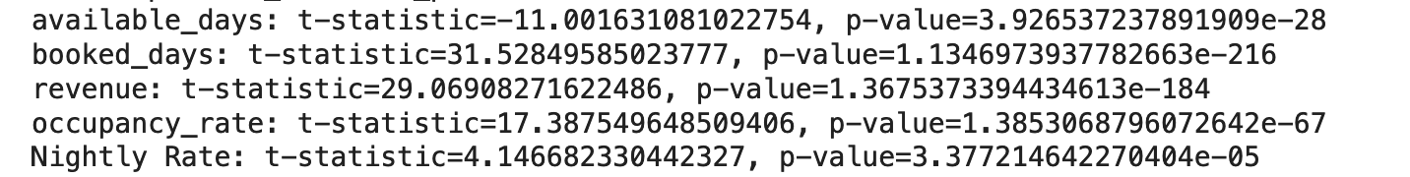
Being a Super host enhances value creation!
Performed T test and got there is a significant difference between Host and Super host.
Available days
Booked days
Occupancy rate
Nightly rate

Slide 21
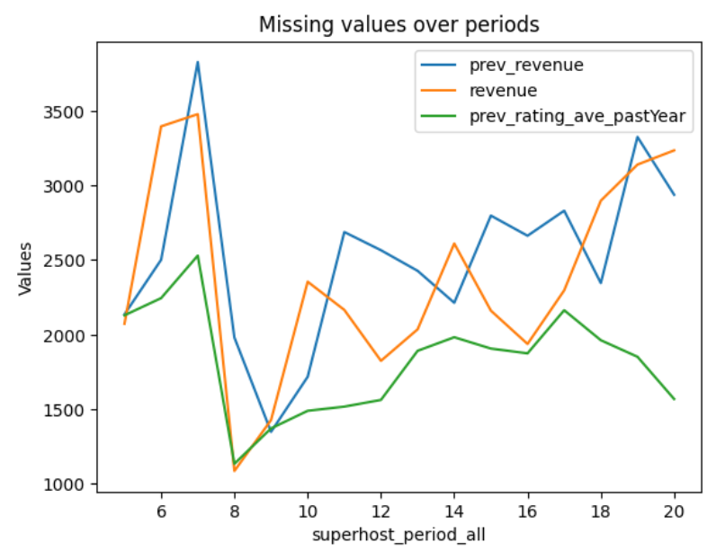
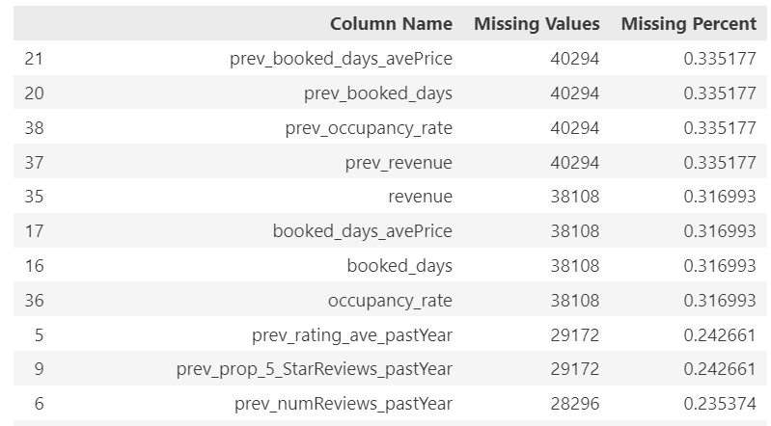
Handling Missing Values
We saw a very high number of missing values in our data – upto 34% in some variables
Also the missing values were distributed pretty evenly over the periods

Slide 22
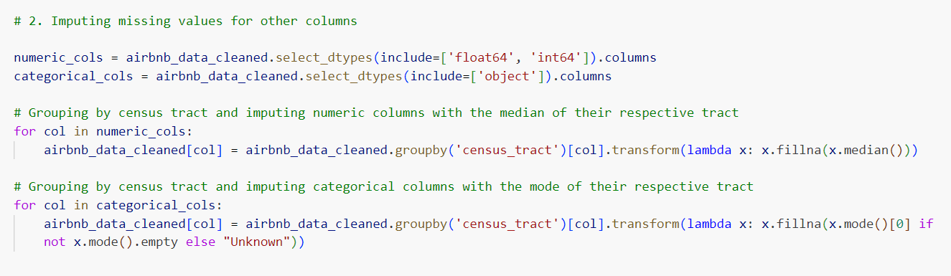
Handling Missing Values
We dropped the rows which had missing values for revenue
Properties in the same geographical area have similar metric values, hence for other variables we used the tract mean for the numerical variables and the tract median for categorical variables.

Slide 23
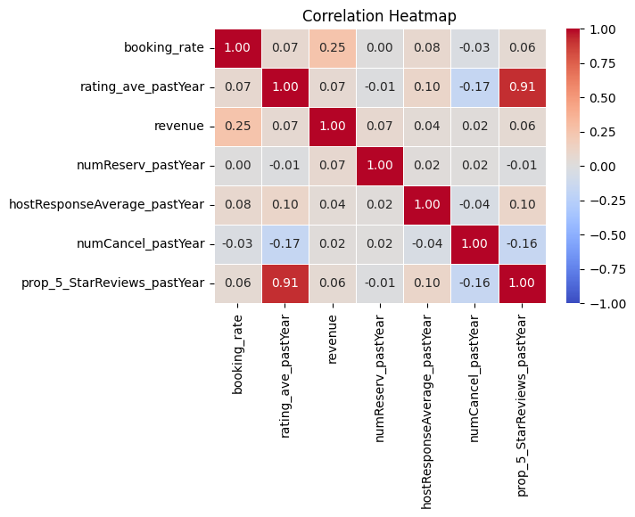
Interdependence of variables
Negative correlation of reservations with ratings and 5starreviews is surprising.
More booking rate results into more revenue, is understandable.
Positive correlation between reservations and cancellations suggests that even when the reservations increase, cancellations increase.
Avg-rating and 5stars high correlation is obvious
More cancellations negatively impact the average rating.

Slide 24
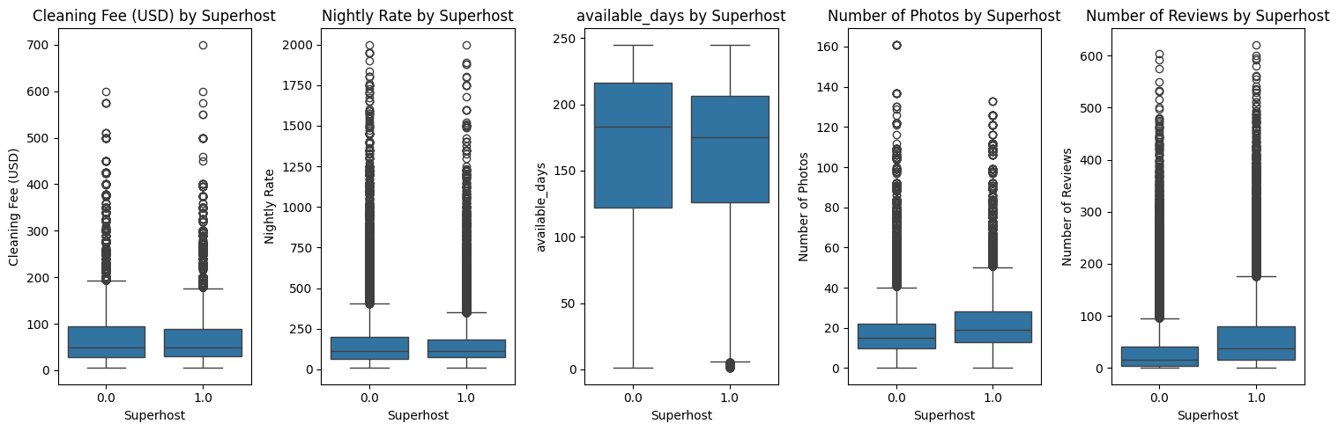
Distribution of different variables based on superhost status
Most notable differences are in the number of photos and the number of reviews.
Superhosts tend to get higher reviews on average

Slide 25
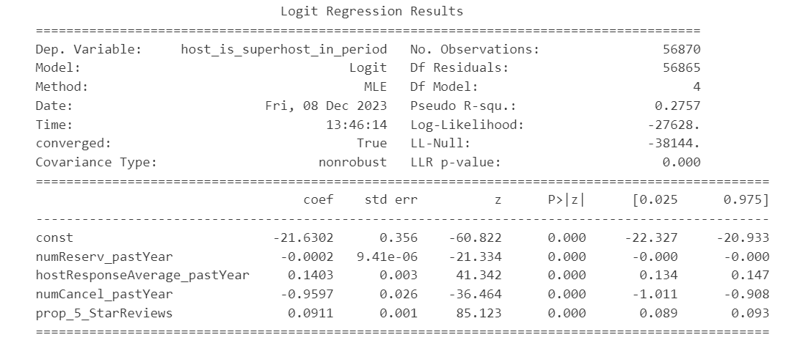
Ability of different variables to predict the superhost status

Slide 26
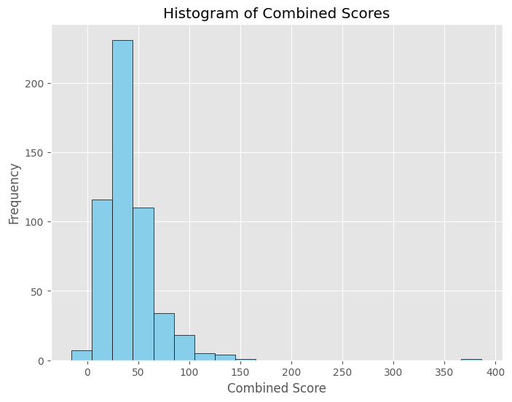
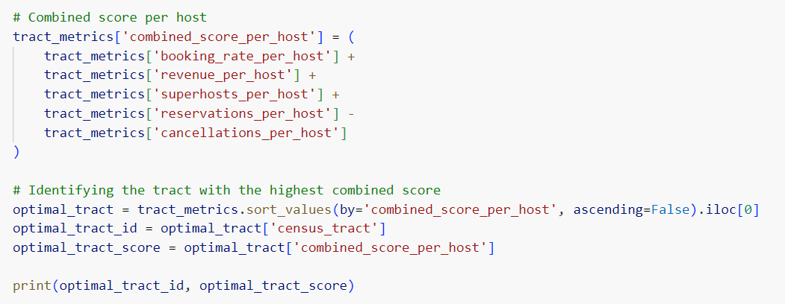
Optimal Tract Selection Method

Slide 27
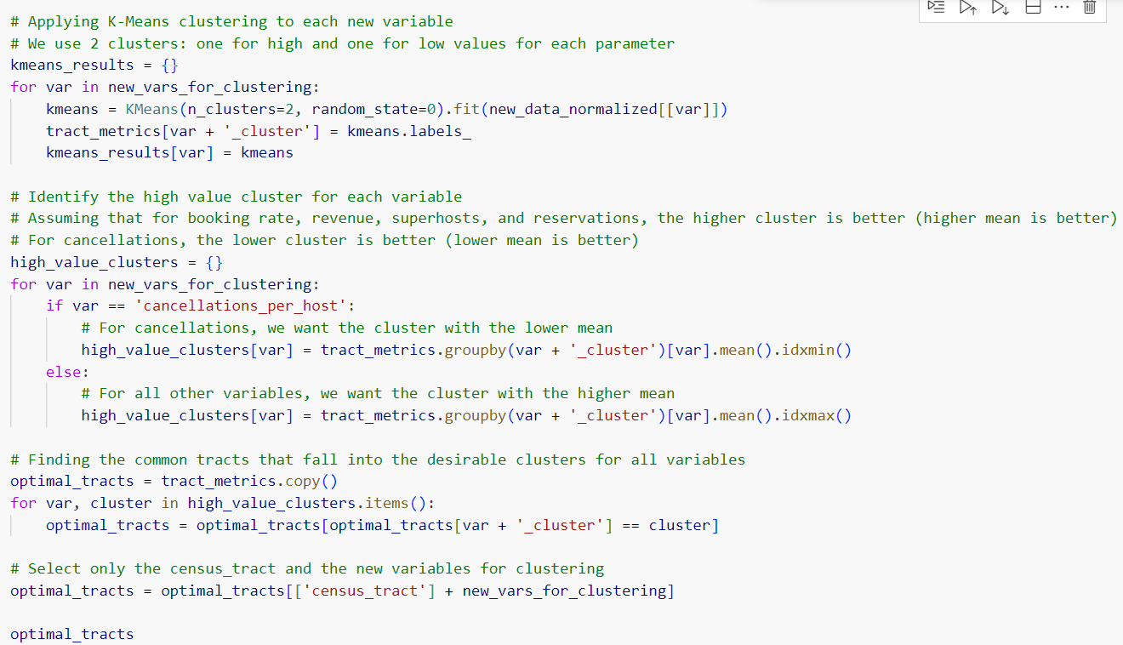
Another Tract Selection Method

